Slide 1
Camera NW performance
05/03/2010

Slide 2
NP244,NF284,NS202,NS954,NW484,NP1004

Slide 3
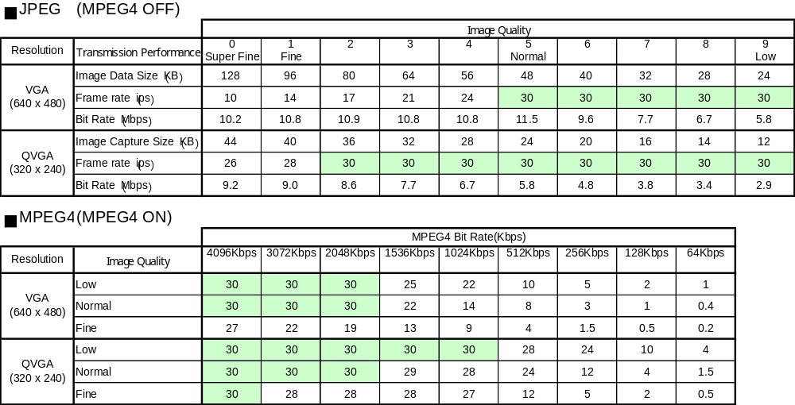
Frame Rate Table (Camera)
WV-NP244, NS202, NF284, NW484S, NS954, NW964 (Individual Output)

Slide 4
Frame Rate Table (Camera)
JPEG frame rate table according to multi user access (WV-NP244, NS202A, NF284, NW484S, NS954, NW964)
# of user access | JPEG frame rate
1 user | 30 fps
2 user | 16 fps
3 user | 10 fps
4 user | 8 fps
5 user | 6 fps
6 user | 5 fps
7 user | 4 fps
8 user | 4 fps
Setting conditions
Refresh interval (JPEG): 30fps
Image capture size: VGA
Image quality: 6 (about 42KB)
MPEG-4 transmission: OFF
Audio mode: OFF
VMD alarm: OFF

Slide 5
Frame Rate Table (Camera)
MPEG-4 frame rate table according to multi user access (WV-NP244, NS202A, NF284, NW484S, NS954, NW964)
Simple subject
Complicated subject
# of user access | MPEG-4 max bit rate
 | 4096 kbps | 2048 kbps | 1024 kbps | 512 kbps | 64 kbps
1user | 30 fps | 30 fps | 29 fps | 17 fps | 0.6 fps
2user | 30 fps | 30 fps | 29 fps | 17 fps | 0.6 fps
3user | N/A | 30 fps | 29 fps | 17 fps | 0.6 fps
4user | N/A | 30 fps | 29 fps | 17 fps | 0.6 fps
5user | N/A | N/A | 29 fps | 17 fps | 0.6 fps
6user | N/A | N/A | 29 fps | 17 fps | 0.6 fps
7user | N/A | N/A | 29 fps | 17 fps | 0.6 fps
8user | N/A | N/A | 29 fps | 17 fps | 0.6 fps
# of user access | MPEG-4 max bit rate
 | 4096 kbps | 2048 kbps | 1024 kbps | 512 kbps | 64 kbps
1user | 30 fps | 30 fps | 15 fps | 6 fps | 0.1 fps
2user | 30 fps | 30 fps | 15 fps | 6 fps | 0.1 fps
3user | N/A | 30 fps | 15 fps | 6 fps | 0.1 fps
4user | N/A | 30 fps | 15 fps | 6 fps | 0.1 fps
5user | N/A | N/A | 15 fps | 6 fps | 0.1 fps
6user | N/A | N/A | 15 fps | 6 fps | 0.1 fps
7user | N/A | N/A | 15 fps | 6 fps | 0.1 fps
8user | N/A | N/A | 15 fps | 6 fps | 0.1 fps
Setting conditions
MPEG-4 transmission: ON
Image capture size: VGA
Image quality: Normal
Refresh interval : 3sec
Audio mode: OFF
VMD alarm: OFF
Setting conditions
MPEG-4 transmission: ON
Image capture size: VGA
Image quality: Normal
Refresh interval : 3sec
Audio mode: OFF
VMD alarm: OFF

Slide 6
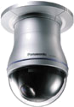
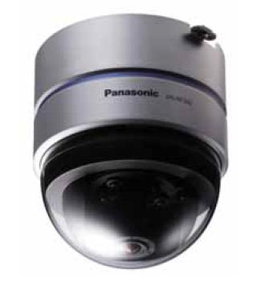
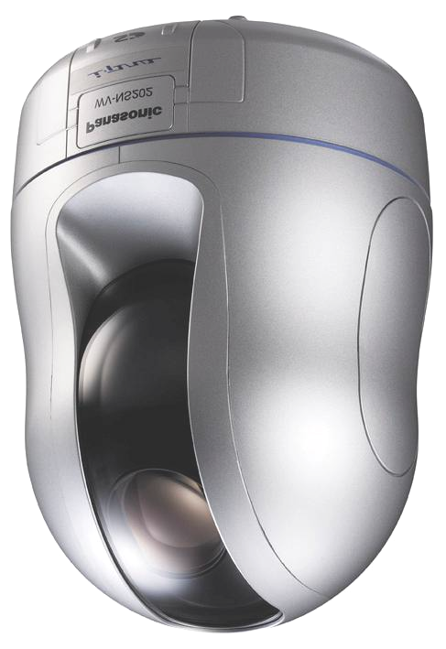
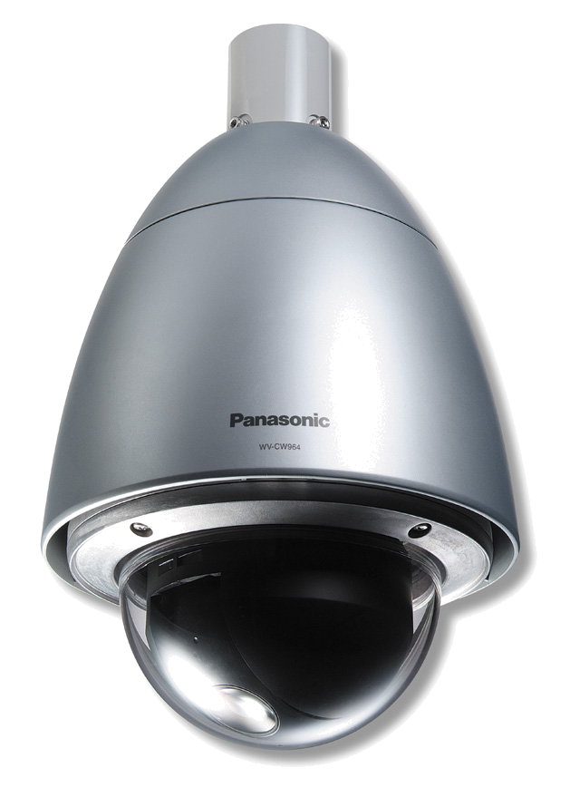
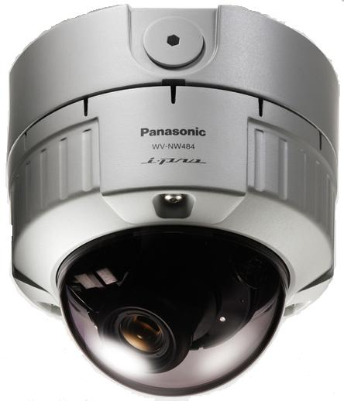
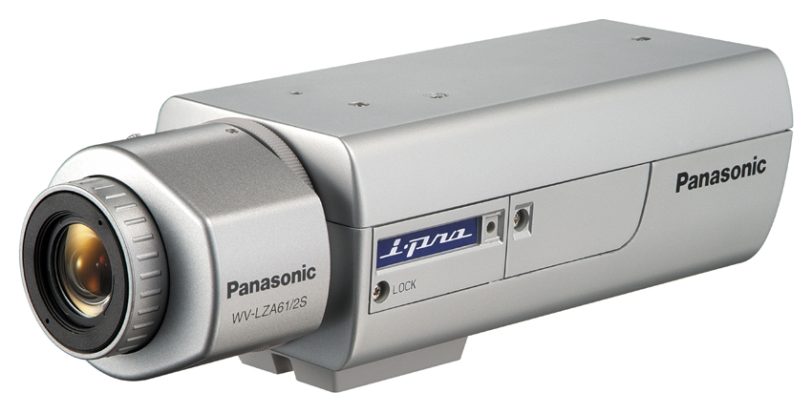
Frame Rate Table (Camera)
WV-NP244, NS202A, NF284, NW484S, NS954, NW964 (Dual Output)
JPEG + MPEG-4*
JPEG(VGA) max.5fps
JPEG(QVGA) max.10fps
MPEG-4 max.15fps
(VGA or QVGA)
*encoding schedule is fixed

Slide 7
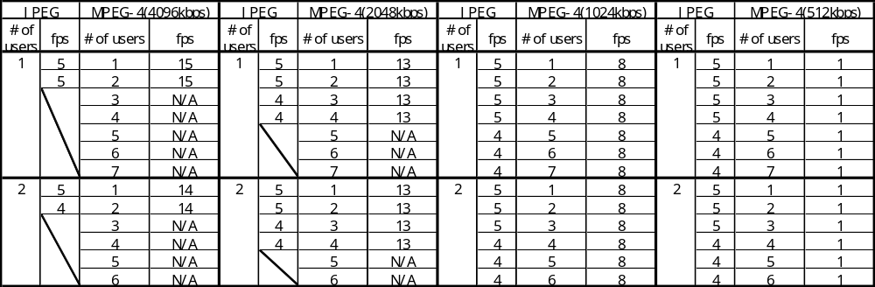
Frame Rate Table (Camera)
WV-NP244, NS202, NF284, NW484S, NS954, NW964 (Dual Output)
Setting conditions
JPEG : Picture quality 5(Normal), Resolution VGA
MPEG-4 : Picture quality Normal, Resolution VGA, I-frame interval 1sec
SD backup: OFF, Audio: OFF

Slide 8
Frame Rate Table (Camera)
Frame rate priority mode (WV-NS954/NW964)
MPEG-4 mode |  | Frame rate | Bit rate | Picture quality
Constant bit rate (WV-NP244, NP1004, NS202A, NF284, NW484S, NS954, NW964) |  | Variable (Depends on the object) | Fixed(64-4096kbps) | Fixed (Fine, Normal, Low)
Flame rate priority (WV-NS964, NW964 only) | 4096kbps | Fixed(30fps) | Variable (0.5~3.5Mbps) | Fixed
 | Unlimited | Fixed(30fps) | Variable (1~4Mbps) | Fixed

Slide 9
User Access Limit (Camera)
Max. # of user access (WV-NP244, NS202A, NF284, NW484S, NS954, NW964)
Max bit rate | Max # of MPEG-4 user | Max # of MPEG-4 and JPEG user
4096 kbps | 2 user | 8 user
3072 kbps | 2 user | 8 user
2048 kbps | 4 user | 8 user
1536 kbps | 6 user | 8 user
1024 kbps | 8 user | 8 user
512 kbps | 8 user | 8 user
256 kbps | 8 user | 8 user
128 kbps | 8 user | 8 user
64 kbps | 8 user | 8 user

Slide 10
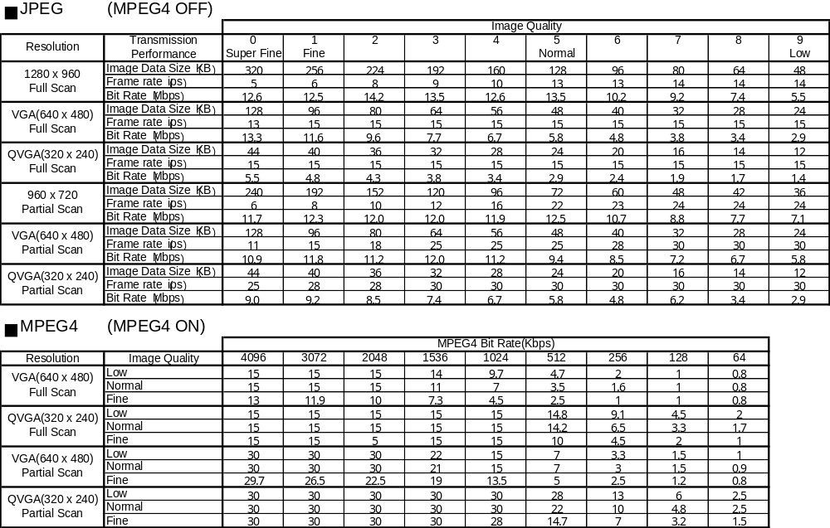
Frame Rate Table (Camera)
WV-NP1004 (Individual Output)

Slide 11
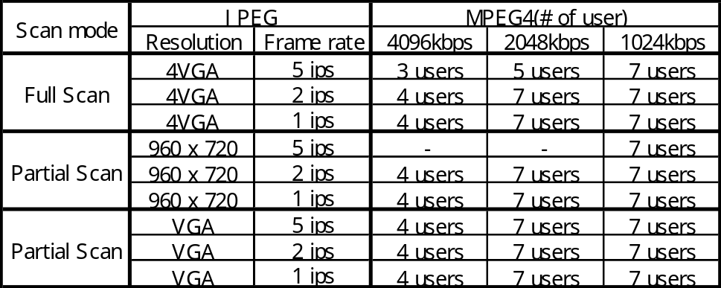
Frame Rate Table (Camera)
WV-NP1004 (Dual Output)
When setting JPEG 5ips at dual mode, MPEG-4 should be set 1024kbps or less in order to keep JPEG frame rate.
*MPEG-4 is measured value with the condition of unicast and normal quality.
Frame rate of MPEG-4 is same as individual output.

Slide 12
NP502,NW502

Slide 13
H.264 stream performance
H.264 constant bit rate mode (1 User, Audio=Off, Refresh-Interval=3s)
Bit rate (kbps) |  |  |  | 64 | 128 | 256 | 384 | 512 | 768 | 1,024 | 1,536 | 2,048 | 3,072 | 4,096 | 8,192
1.3 Mega Pixel mode （30fps） | Frame rate (target) | QVGA | Fine | 1 | 2 | 5 | 7.5 | 10 | 15 | 15 | 20 | 30 | 30 | 30
 |  |  | Normal | 5 | 10 | 15 | 20 | 25 | 30 | 30 | 30 | 30 | 30 | 30
 |  |  | Low | 10 | 15 | 25 | 30 | 30 | 30 | 30 | 30 | 30 | 30 | 30
 |  | VGA | Fine | 1 | 1 | 2 | 3 | 5 | 7.5 | 10 | 15 | 15 | 20 | 22.5
 |  |  | Normal | 2 | 5 | 7.5 | 10 | 15 | 20 | 22.5 | 30 | 30 | 30 | 30
 |  |  | Low | 3 | 7.5 | 10 | 15 | 20 | 30 | 30 | 30 | 30 | 30 | 30
 |  | 4VGA | Fine |  |  | 1 | 1 | 2 | 3 | 5 | 7.5 | 10 | 15 | 20 | 30
 |  |  | Normal |  |  | 1 | 2 | 3 | 5 | 7.5 | 10 | 20 | 25 | 30 | 30
 |  |  | Low |  |  | 3 | 5 | 7.5 | 10 | 15 | 20 | 30 | 30 | 30 | 30
3Mega Pixel mode （15fps） | Frame rate (target) | QVGA | Fine | 1 | 2 | 5 | 7.5 | 10 | 15 | 15 | 15 | 15 | 15 | 15
 |  |  | Normal | 5 | 10 | 15 | 15 | 15 | 15 | 15 | 15 | 15 | 15 | 15
 |  |  | Low | 10 | 15 | 15 | 15 | 15 | 15 | 15 | 15 | 15 | 15 | 15
 |  | VGA | Fine | 1 | 1 | 2 | 3 | 5 | 7.5 | 10 | 15 | 15 | 15 | 15
 |  |  | Normal | 2 | 5 | 7.5 | 10 | 15 | 15 | 15 | 15 | 15 | 15 | 15
 |  |  | Low | 3 | 7.5 | 10 | 15 | 15 | 15 | 15 | 15 | 15 | 15 | 15
 |  | 4VGA | Fine |  |  | 1 | 1 | 2 | 3 | 5 | 7.5 | 10 | 15 | 15 | 15
 |  |  | Normal |  |  | 1 | 2 | 3 | 5 | 7.5 | 10 | 15 | 15 | 15 | 15
 |  |  | Low |  |  | 3 | 5 | 7.5 | 10 | 15 | 15 | 15 | 15 | 15 | 15
H.264 frame rate priority mode (1 User, Audio=Off, Refresh-Interval=3s)
Bit rate (kbps) |  |  | 64 | 128 | 256 | 384 | 512 | 768 | 1,024 | 1,536 | 2,048 | 3,072 | 4,096 | 8,192 | Unlimited
1.3 Mega Pixel mode （30fps） | Frame rate (target) | QVGA | 10 | 15 | 20 | 30 | 30 | 30 | 30 | 30 | 30 | 30 | 30 |  | 30
 |  | VGA | 3 | 7.5 | 10 | 15 | 20 | 30 | 30 | 30 | 30 | 30 | 30 |  | 30
 |  | 4VGA |  |  | 3 | 5 | 7.5 | 10 | 15 | 20 | 30 | 30 | 30 | 30 | 30
3Mega Pixel mode（15fps） | Frame rate (target) | QVGA | 10 | 15 | 15 | 15 | 15 | 15 | 15 | 15 | 15 | 15 | 15 |  | 15
 |  | VGA | 3 | 7.5 | 10 | 15 | 15 | 15 | 15 | 15 | 15 | 15 | 15 |  | 15
 |  | 4VGA |  |  | 3 | 5 | 7.5 | 10 | 15 | 15 | 15 | 15 | 15 | 15 | 15
Frame mode can be selected from the following. 1fps / 3fps / 5fps / 7.5fps / 10fps / 15fps / 20fps* / 30fps* * 1.3Mpixel mode only
Notice. These charts are target performance. Performance would be changed by the contrast or the motion in picture.
8

Slide 14
MPEG-4 stream performance
MPEG-4 constant bit rate mode (1 User, Audio=Off, Refresh-Interval=3s)
Bit rate (kbps) |  |  |  | 64 | 128 | 256 | 384 | 512 | 768 | 1,024 | 1,536 | 2,048 | 3,072 | 4,096
1.3 Mega Pixel mode （30fps） | Frame rate (target) | QVGA | Fine | 1 | 2 | 5 | 7.5 | 10 | 15 | 15 | 20 | 30 | 30 | 30
 |  |  | Normal | 2 | 5 | 10 | 15 | 20 | 25 | 30 | 30 | 30 | 30 | 30
 |  |  | Low | 5 | 10 | 20 | 25 | 30 | 30 | 30 | 30 | 30 | 30 | 30
 |  | VGA | Fine | 1 | 1 | 2 | 3 | 5 | 7.5 | 10 | 15 | 15 | 20 | 22.5
 |  |  | Normal | 1 | 2 | 5 | 7.5 | 10 | 15 | 15 | 22.5 | 30 | 30 | 30
 |  |  | Low | 2 | 5 | 7.5 | 10 | 10 | 15 | 20 | 25 | 30 | 30 | 30
3Mega Pixel mode （15fps） | Frame rate (target) | QVGA | Fine | 1 | 2 | 5 | 7.5 | 10 | 15 | 15 | 15 | 15 | 15 | 15
 |  |  | Normal | 2 | 5 | 10 | 15 | 15 | 15 | 15 | 15 | 15 | 15 | 15
 |  |  | Low | 5 | 10 | 15 | 15 | 15 | 15 | 15 | 15 | 15 | 15 | 15
 |  | VGA | Fine | 1 | 1 | 2 | 3 | 5 | 7.5 | 10 | 15 | 15 | 15 | 15
 |  |  | Normal | 1 | 2 | 5 | 7.5 | 10 | 15 | 15 | 15 | 15 | 15 | 15
 |  |  | Low | 2 | 5 | 7.5 | 10 | 10 | 15 | 15 | 15 | 15 | 15 | 15
MPEG-4 frame rate priority mode (1 User, Audio=Off, Refresh-Interval=3s)
Bit rate (kbps) |  |  | 64 | 128 | 256 | 384 | 512 | 768 | 1,024 | 1,536 | 2,048 | 3,072 | 4,096 | Unlimited
1.3 Mega Pixel mode （30fps） | Frame rate (target) | QVGA | 5 | 10 | 20 | 20 | 30 | 30 | 30 | 30 | 30 | 30 | 30 | 30
 |  | VGA | 3 | 5 | 7.5 | 10 | 10 | 15 | 20 | 20 | 30 | 30 | 30 | 30
3Mega Pixel mode （15fps） | Frame rate (target) | QVGA | 5 | 10 | 15 | 15 | 15 | 15 | 15 | 15 | 15 | 15 | 15 | 15
 |  | VGA | 3 | 5 | 7.5 | 10 | 10 | 15 | 15 | 15 | 15 | 15 | 15 | 15
Frame mode can be selected from the following. 1fps / 3fps / 5fps / 7.5fps / 10fps / 15fps / 20fps* / 30fps* * 1.3Mpixel mode only
Notice. These charts are target performance. Performance would be changed by the contrast or the motion in picture.
9

Slide 15
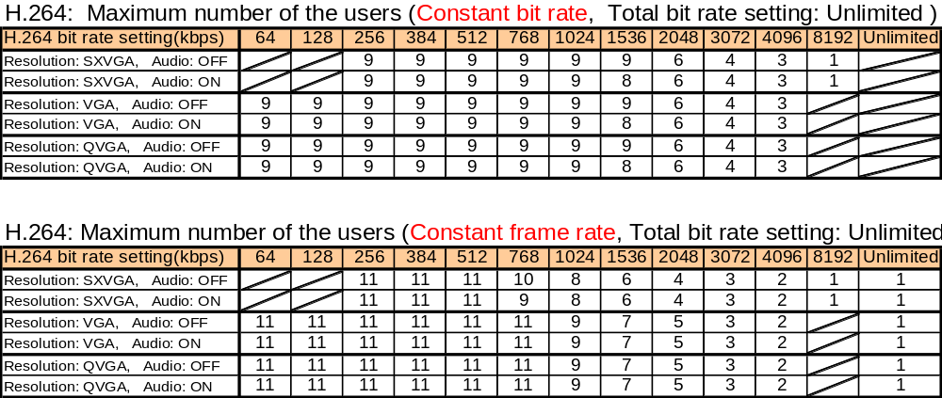
Maximum number of user
Update: Apr. 06 2009
Constant bit rate mode
Frame rate priority mode

Slide 16
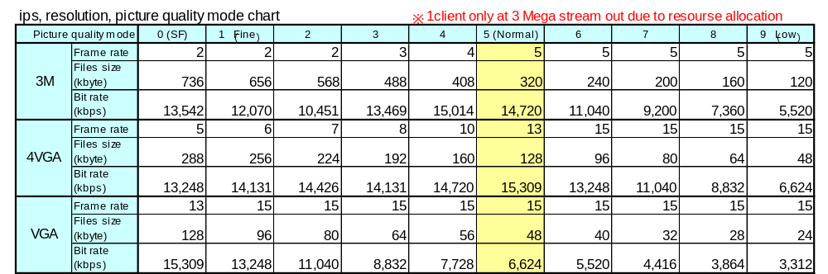
ＤＧ－ＮＰ５０２・ＤＧ－ＮＷ５０２Ｓ 配信性能④
■ JPEG throughput capability at H.264/MPEG4 OFF and 3M mode
Frame rate # is reference. File size and ips are influenced by complexity of surveillance objects movement

